Slide 1


Team 71: Microservices Management for Distributed Computation Bi-Weekly Update 4 Elizabeth Weichel Sponsor: Dr. Srinivas Shakkottai PhD: Ujwal Dinesha Master’s: Prathik Vijaykumar TA: Souryendu Das
Notes:
Michelle

Slide 2
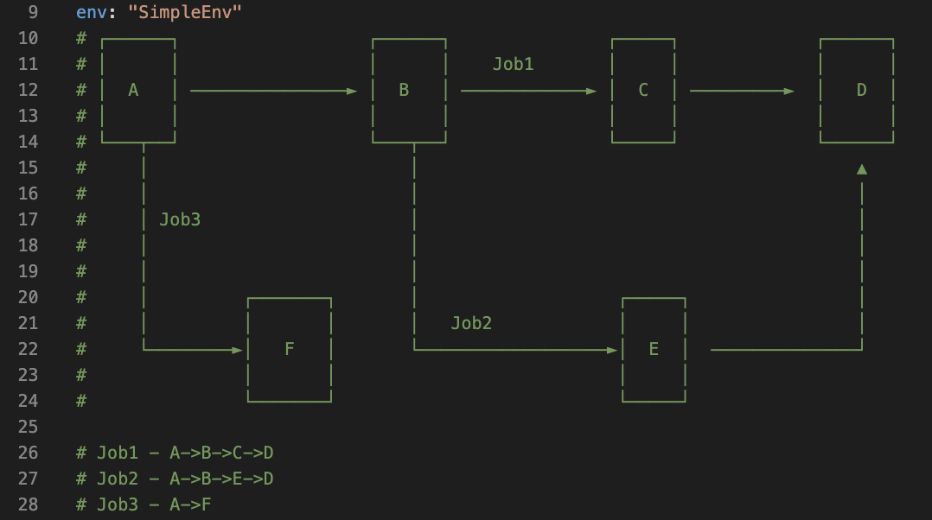
Project Summary
Problem: Autoscaling microservices using ML (& RL)
Goal: Previous research focuses upon e-e latency, and autoscaling individual containers, we will focus on container-level latency and combinations of possibilities for containers
Screenshot from simpleenv, the first microservices environment used with the simulator. Written by Ujwal Dinesha.
Notes:
Kyle

Slide 3
Project/Subsystem Overview
Simulator
Real System
Testing functionality ✅
Testing basic algos ✅ Testing complex algos
Testing functionality
Testing basic algos
Testing complex algos
Notes:
Eric

Slide 4
Project Timeline
Simulator finished (completed 2/4) | Simulator tested without algorithm (completed 2/5) | Simulator tested with basic algorithms (to complete by 2/20) | Tree-based bandit tested on simulator | Real system complete (3/6) | Algos tested on real system (4/3) | Data compiled and robustness of systems tested w/ simulator vs real (4/17) | Complete system eval report (5/1)
Part of this will also involve implementing previously made algos on our system in order to give us targets for our algo to beat.
Notes:
Eric

Slide 5
URS Requirements
Accomplishments since 403 | Ongoing progress/problems and plans until the next presentation
Poster presentation and 4000 words took majority of week 1 of bloc | Keep working on final thesis

Slide 6
Container Level Latencies
Accomplishments since 403 | Ongoing progress/problems and plans until the next presentation
Found out that it was not “wholly” correct last presentation, fixed the issues!

Slide 7
Simulator Algos
Accomplishments since 403 | Ongoing progress/problems and plans until the next presentation
Further tested bandit algorithm. Used to implement epsilon-greedy | Building off this – will be implementing UCB instead of Monte Carlo Tree Search

Slide 8
Types of Algos
Simple | Complex
- Simple bandit | COLA*
- PPO epsilon-greedy | Firm*
 | Tree-based UCB
*already created, using will involve implementation

Slide 9
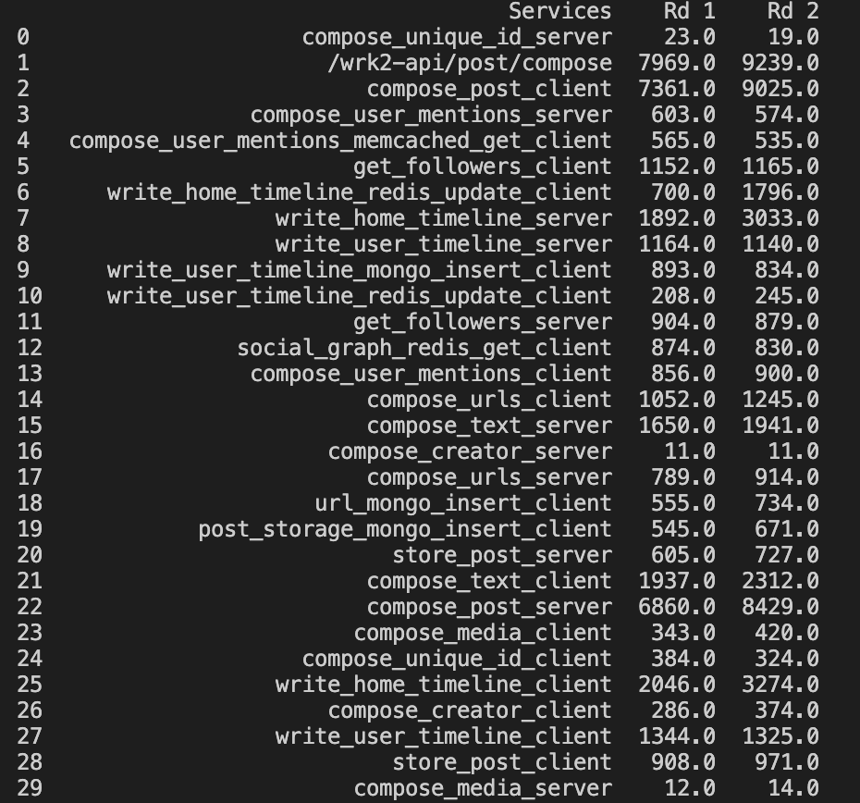
Data to Show Updated Latencies

Slide 10
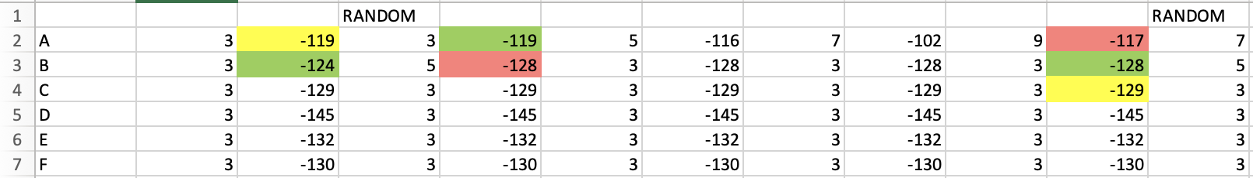
e-greedy
e-greedy average number of iterations to max allocation: 17.8
Bandit average number of iterations to max allocation: 9.8
$$Reward=−∑\left(latencies\right)+λ∗(allocation)$$

Slide 11
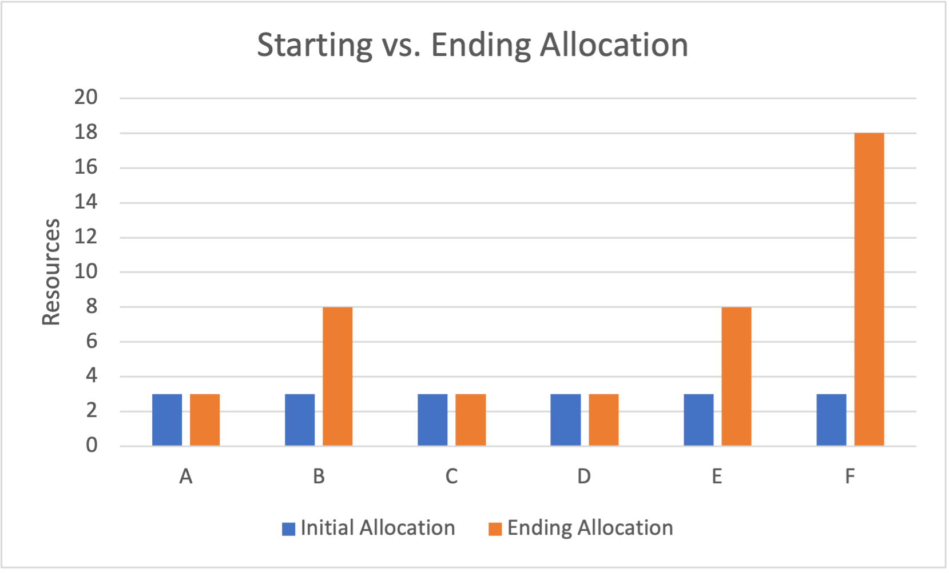
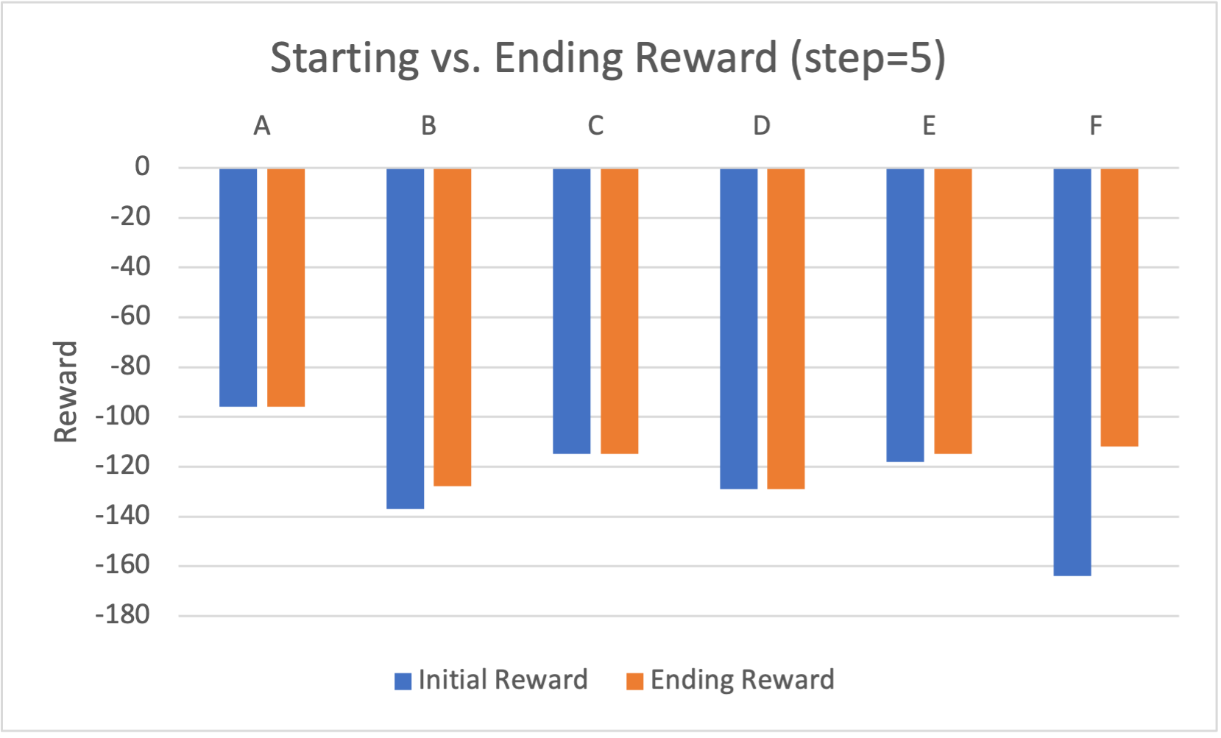
Data from Bandit: varying step size matters!
$$Reward=−∑\left(latencies\right)+λ∗(allocation)$$

Slide 12
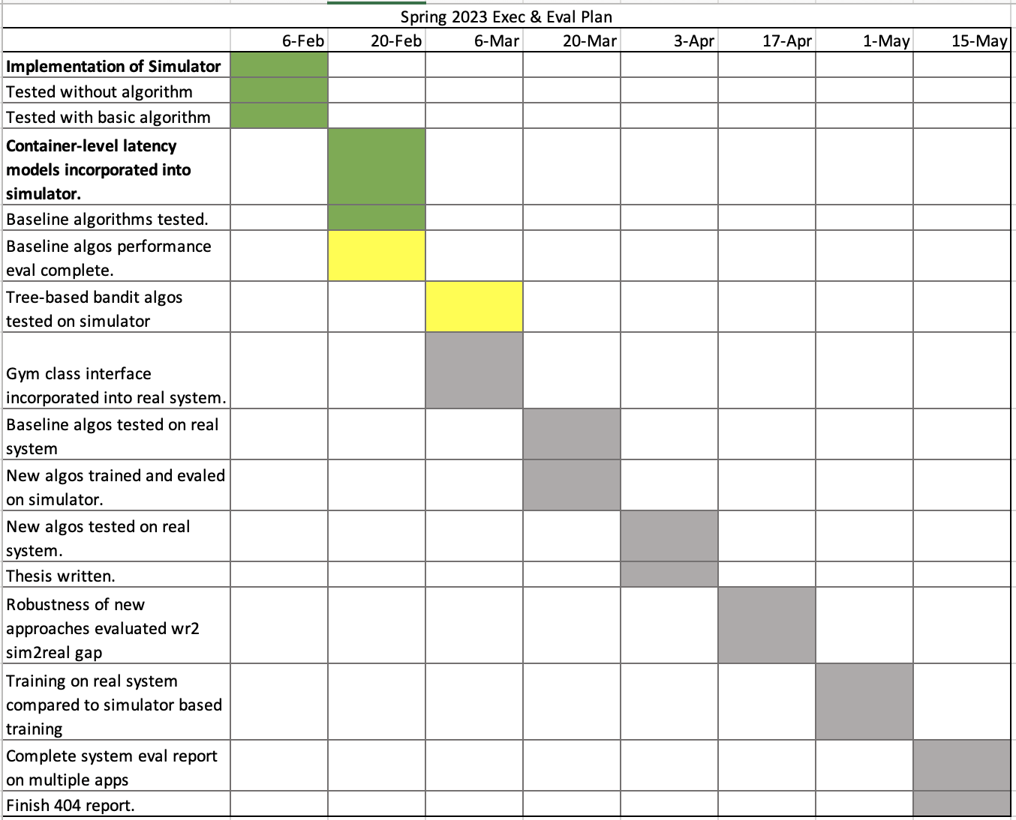
Execution & Plan
Notes:
Michelle

Slide 13
Questions?

